Slide 1

Advanced Techniques in Data Science: Course Project
This project explores the application of advanced data science techniques to analyze a car dataset, uncovering insights and building predictive models.
Ali Saeed (2024-msds-21)

Slide 2
Problem Definition
Objective
Significance
Analyze a car dataset to identify patterns and insights related to car features and prices.
Provides valuable information for both buyers and sellers. Manufacturers can gain insights into customer preferences and trends.

Slide 3
Dataset Overview
Dataset
Features
Car Listings
Model
Year
Km/h
Color
Type
Fuel
Price

Slide 4
Data Cleaning Steps
Step 1
Process
Column Cleaning
Removed commas from 'Km/h' and 'Price', converted to numeric. Standardized column names. Replaced missing values using appropriate techniques (e.g., mean or median). Identified and handled unrealistic values, e.g., 'Year' > 2023.
Missing Values
Outlier Removal

Slide 5
Exploratory Data Analysis (EDA)
EDA Steps
Key Insights
Visualized data distributions
Price trends with Year and Fuel type
Analyzed relationships between features
Identified clusters of high-mileage cars with low prices

Slide 6
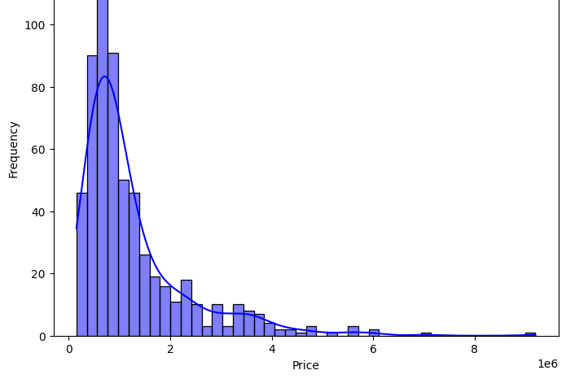
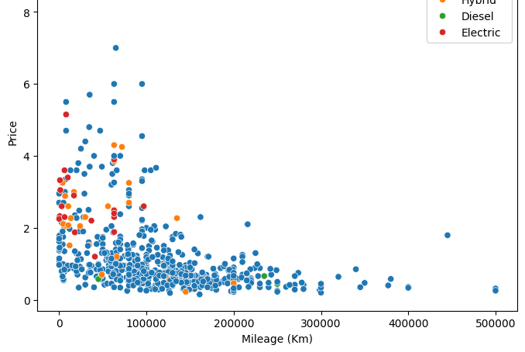
EDA Visualizations

Slide 7
Predictive Modeling Approach
Model Selection
Data Preparation
Regression models (e.g., Linear Regression, Random Forest)
Split data into training (80%) and testing (20%) sets
Classification models (e.g., High, Medium, Low)

Slide 8
Model Optimization
Optimization Techniques
Expected Outcomes
Hyperparameter tuning
Improved accuracy in predicting car prices
Feature selection
Insights into feature importance
Model stacking and ensemble methods

Slide 9
Findings and Insights
Key Findings
Business Insights
Significant correlation between Year and Price
Optimal pricing strategies for different car types
Cars with low mileage have higher prices on average
Insights into customer preferences based on attributes
Fuel type influences pricing trends significantly

Slide 10
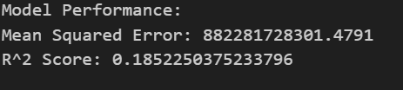
Conclusion & Next Steps
Model Performance
1
Achieved high accuracy, demonstrating the effectiveness of the selected models
Insights Gained
2
Revealed key patterns and relationships in car data, enabling data-driven decisions
Future Exploration
3
Further analyze additional car data, investigate advanced techniques for improving model performance

Slide 11
